Slide 1
Lecture 11: Multilayer Perceptrons
Rui and Andreas

Slide 2
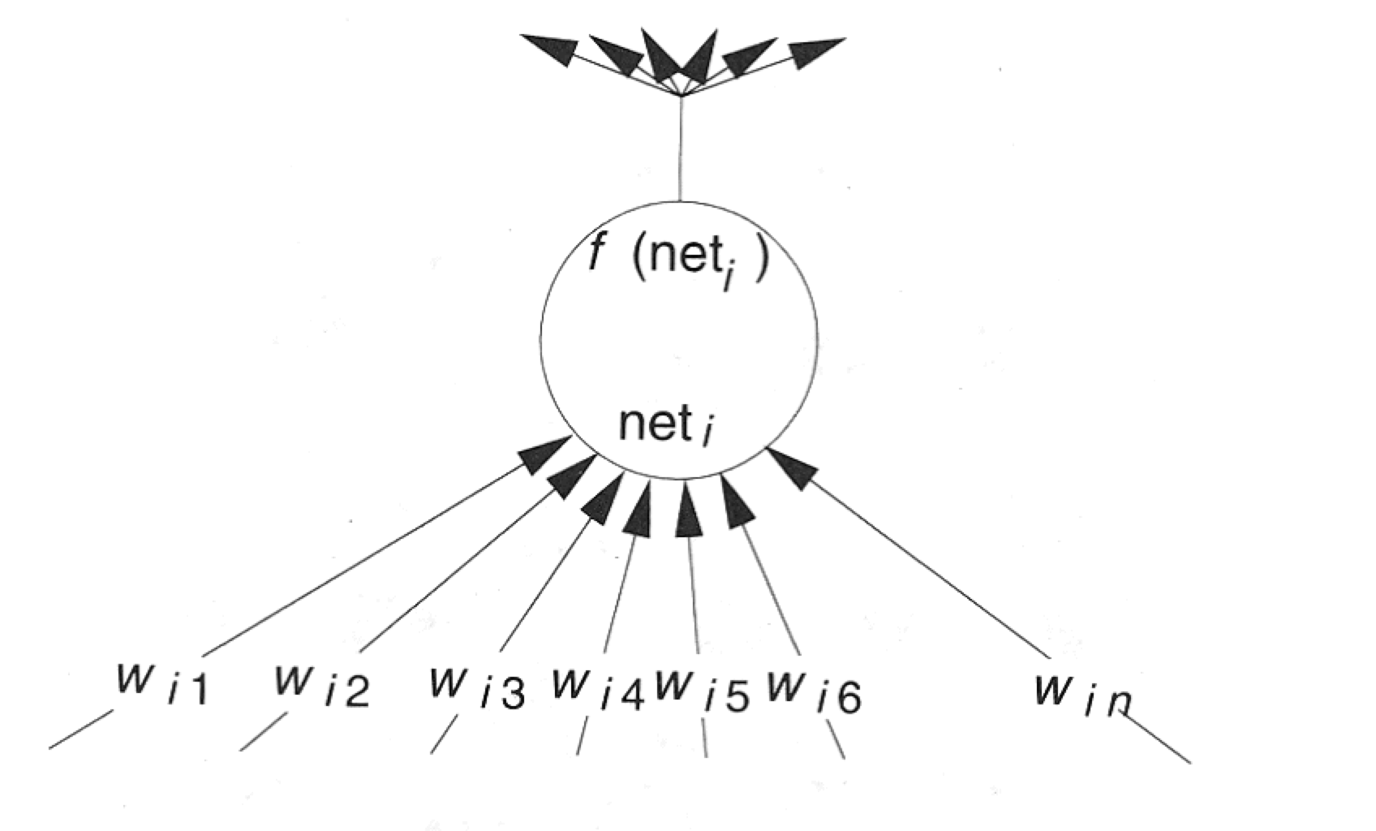
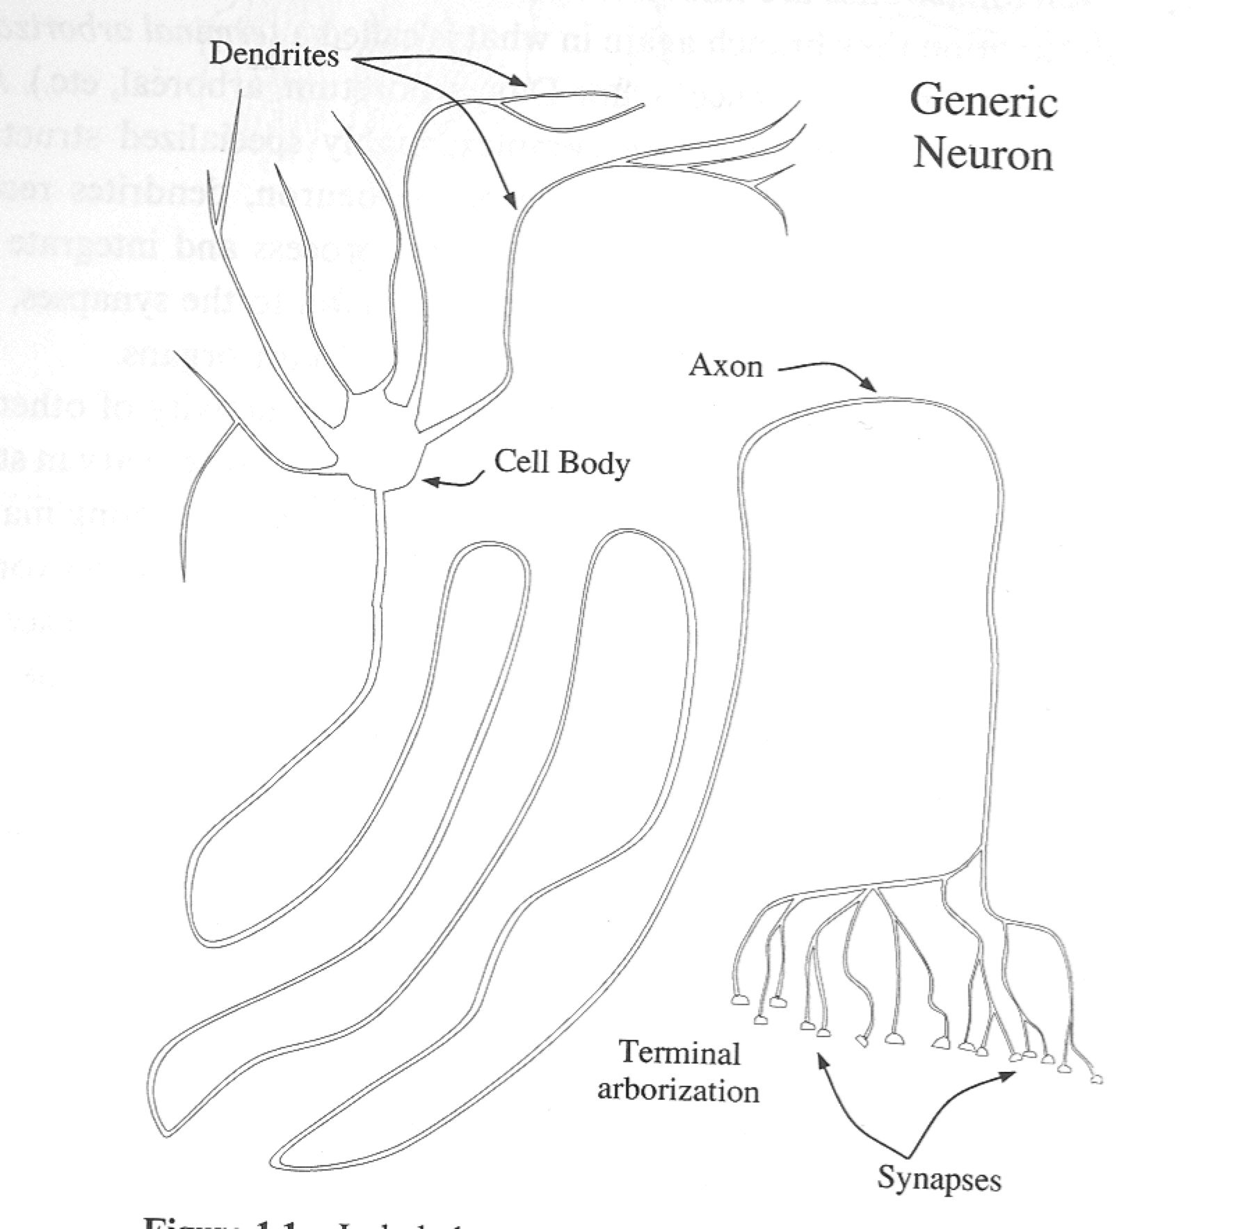
Similarity to real neurons...

Slide 3
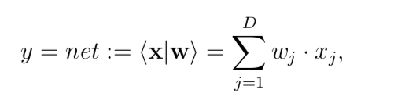
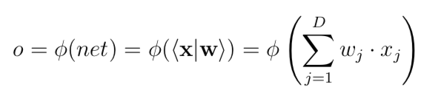
The dot product is a linear representation represented by the value net
Non linearity can be achieved be a non liner activation (transfer) function φ() with

Slide 4
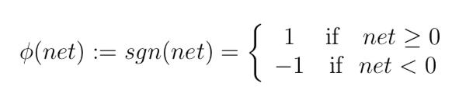
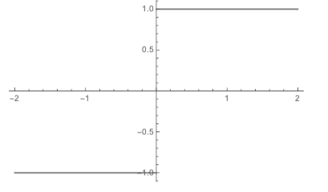
Sgn
Examples of nonlinear transfer functions are the sgn function

Slide 5
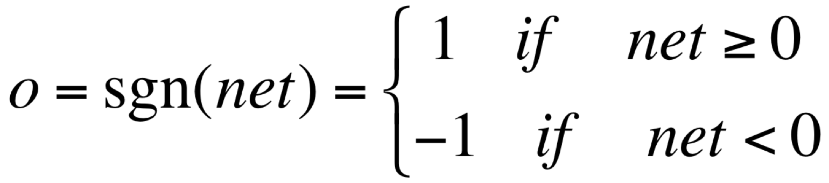
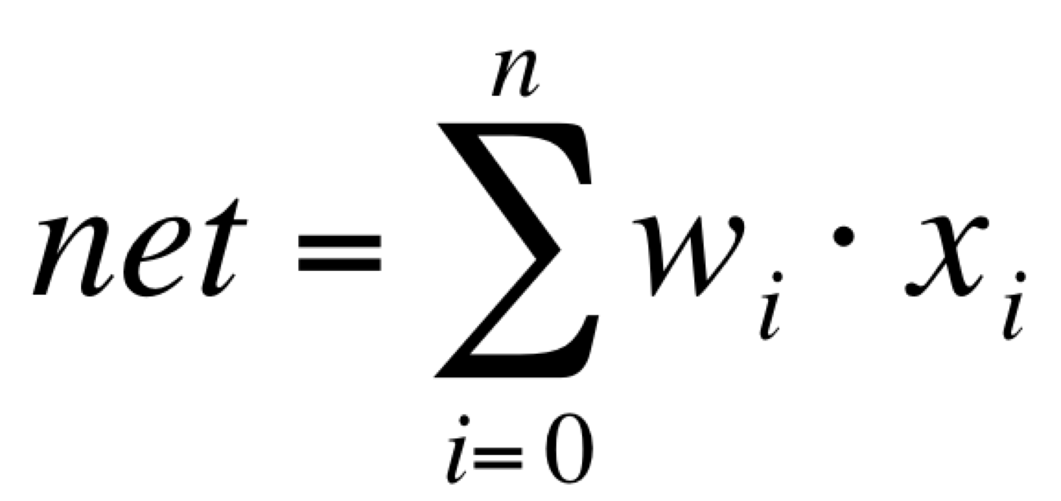
Perceptron (1957)
Linear threshold unit (LTU)
X₀=1
The “bias”, a constant term that does not depend on any input value
x₁
w₁
w₀
w₂
x₂
Σ
o
.
.
.
w_{n}
x_{n}
McCulloch-Pitts model of a neuron (1943)

Slide 6
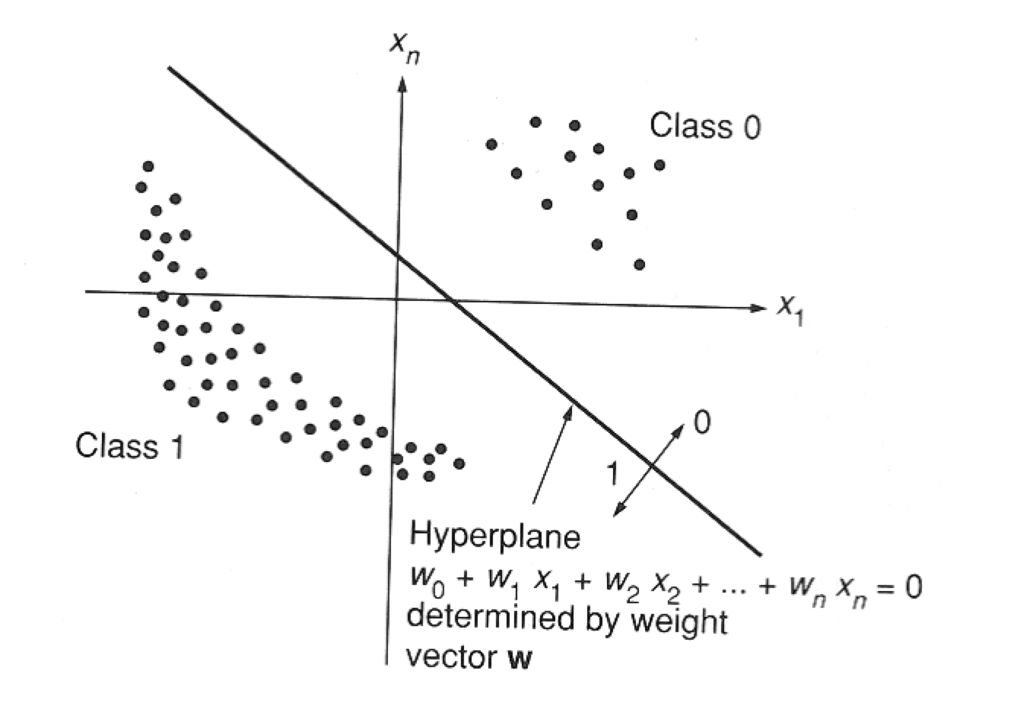
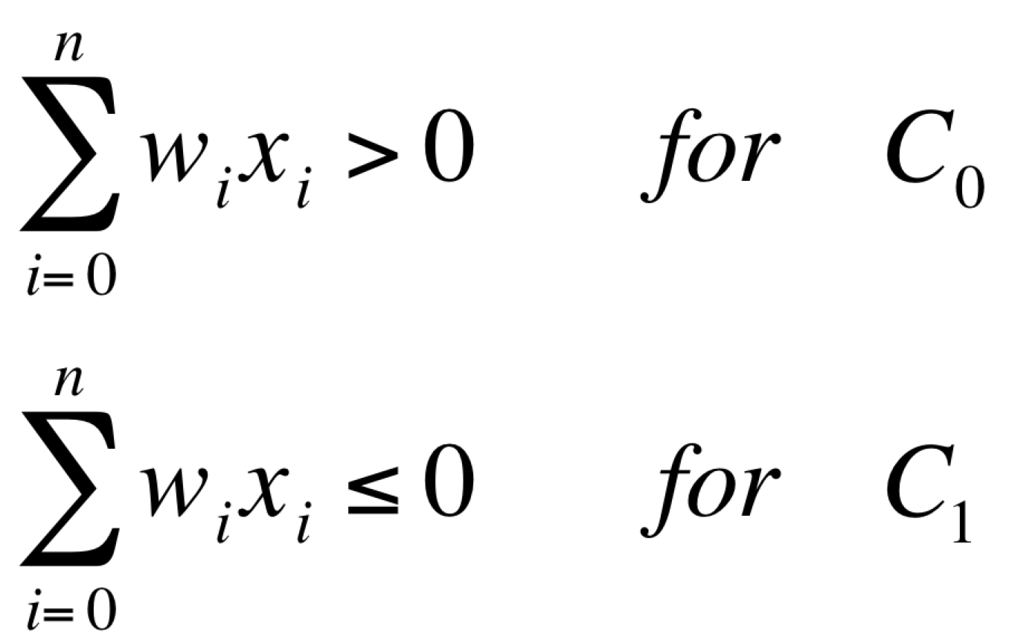
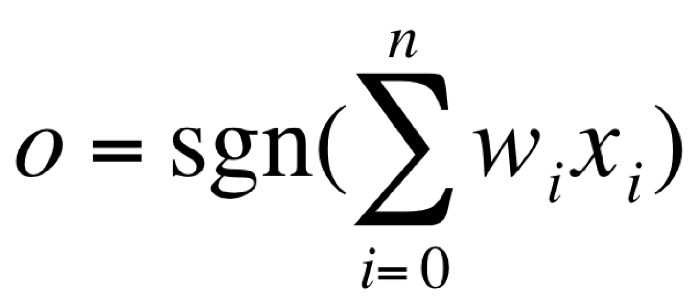
Linearly separable patterns
X₀=1, bias...

Slide 7
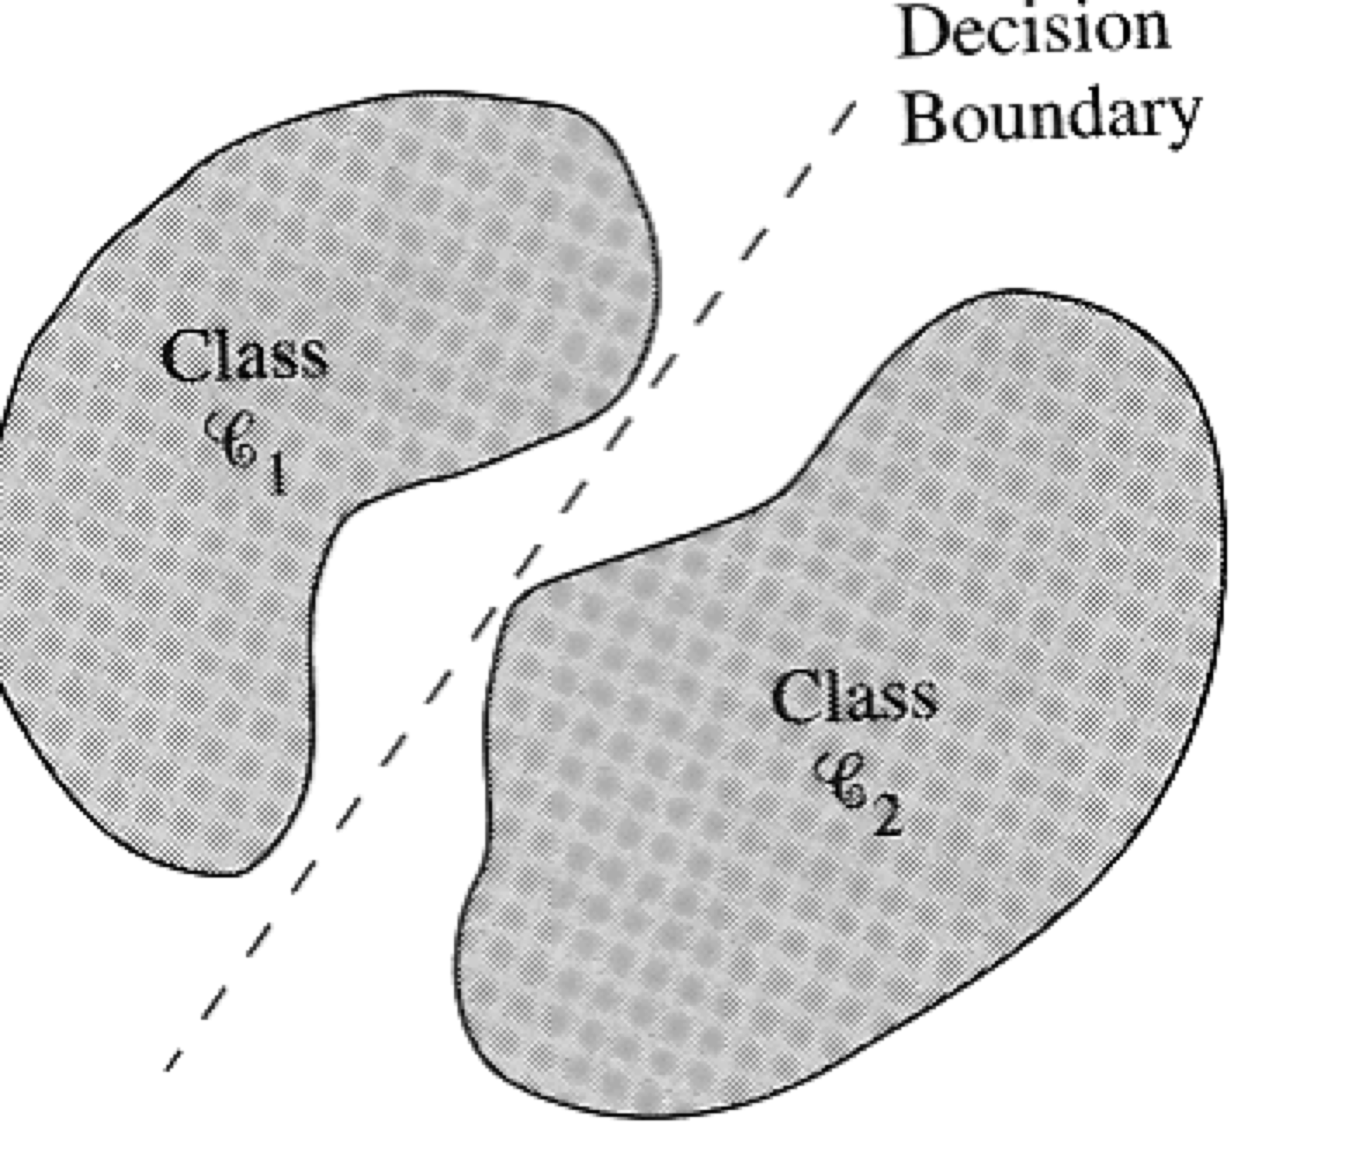
The goal of a perceptron is to correctly classify the set of pattern D={x₁,x₂,..x_{m}} into one of the classes C₁ and C₂
The output for class C₁ is o=1 and for C₂ is o=-1
  For n=2 ➔

Slide 8
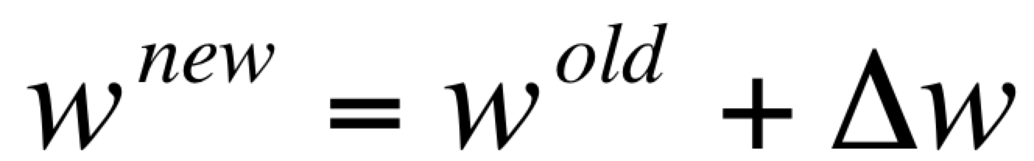
Perceptron learning rule
Consider linearly separable problems
How to find appropriate weights
  Initialize each vector w to some small random values
Look if the output pattern o belongs to the desired class, has the desired value d
η is called the learning rate
0 < η ≤ 1

Slide 9
In supervised learning the network has its output compared with known correct answers
  Supervised learning
  Learning with a teacher
(d-o) plays the role of the error signal
The algorithm converges to the correct classification
  if the training data is linearly separable
  and η is sufficiently small

Slide 10
XOR problem and Perceptron
By Minsky and Papert in mid 1960

Slide 11
Multi-layer Networks
The limitations of simple perceptron do not apply to feed-forward networks with intermediate or „hidden“ nonlinear units
A network with just one hidden unit can represent any Boolean function
The great power of multi-layer networks was realized long ago
  But it was only in the eighties it was shown how to make them learn

Slide 12
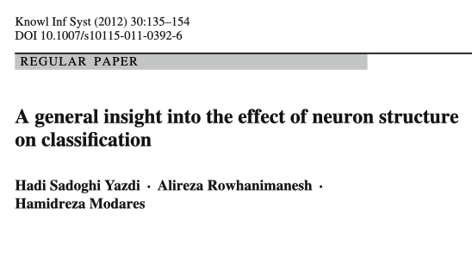
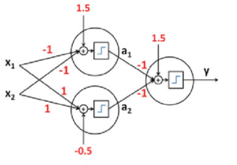
XOR-example

Slide 13
Multiple layers of cascade linear units still produce only linear functions
We search for networks capable of representing nonlinear functions
  Units should use nonlinear activation functions
  Examples of nonlinear activation functions

Slide 14
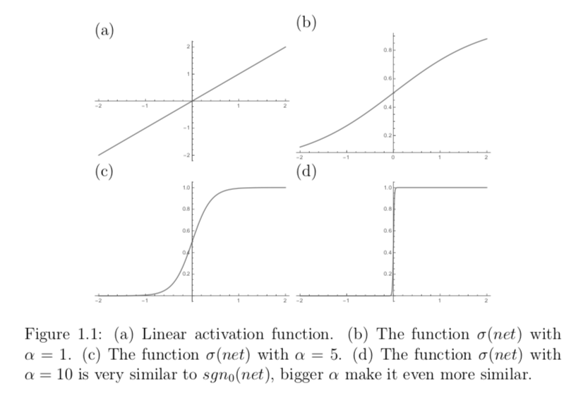
Gradient Descent for one Unit

Slide 15
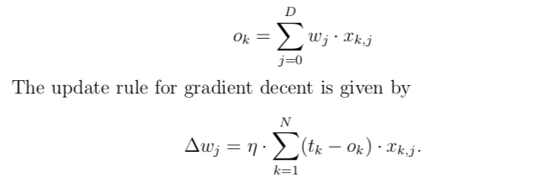
Linear Unit

Slide 16
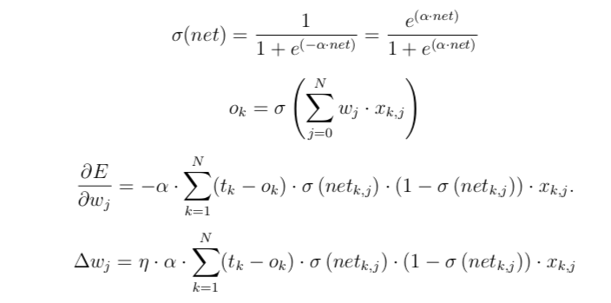
Sigmoid Unit

Slide 17
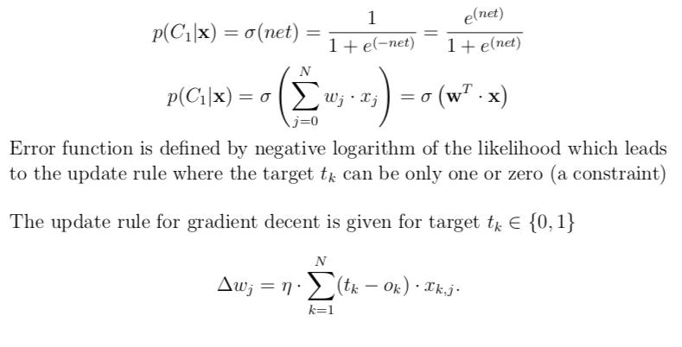
Logistic Regression

Slide 18
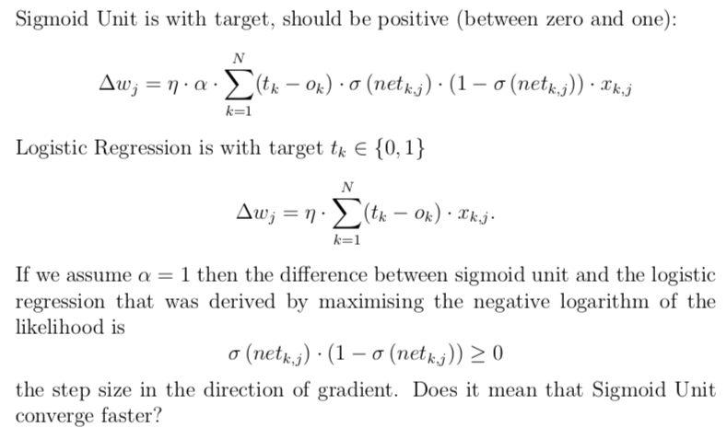
Sigmoid Unit versus Logistic Regression

Slide 19
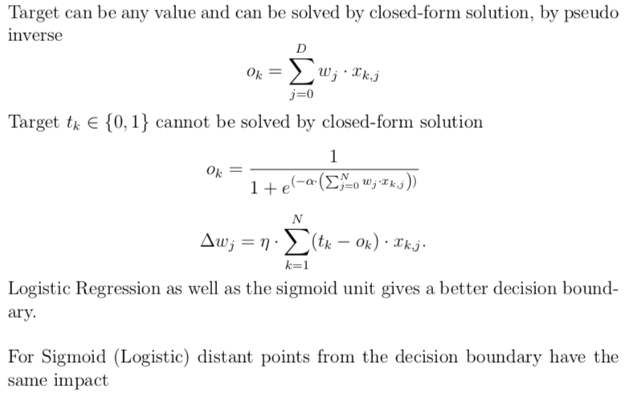
Linear Unit versus Logistic Regression

Slide 20
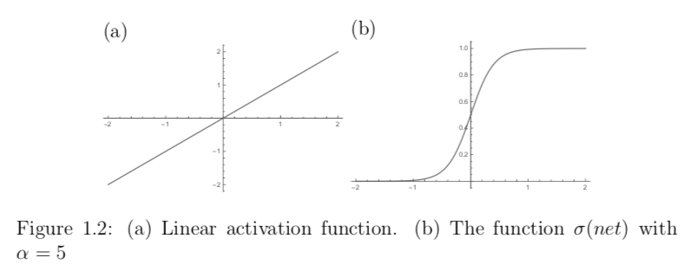
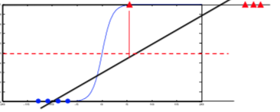
Distance

Slide 21
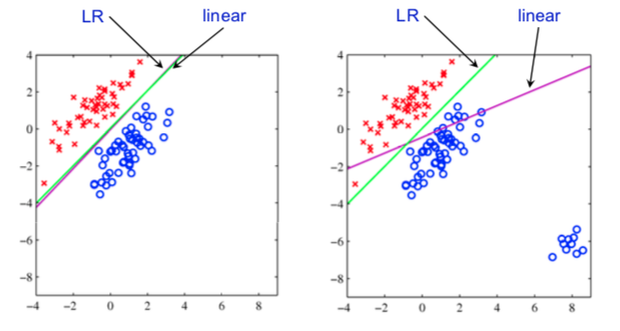
Better Decision Boundary of Logistic Regression LR (sigmoid) to Linear Unit

Slide 22
Back-propagation (1980)
Back-propagation is a learning algorithm for multi-layer neural networks
It was invented independently several times
  Bryson an Ho [1969]
  Werbos [1974]
  Parker [1985]
  Rumelhart et al. [1986]
Parallel Distributed Processing - Vol. 1
Foundations
David E. Rumelhart, James L. McClelland and the PDP Research Group
What makes people smarter than computers? These volumes by a pioneering neurocomputing.....

Slide 23
Feed-forward networks with hidden nonlinear units are universal approximators; they can approximate every bounded continuous function with an arbitrarily small error
Each Boolean function can be represented by a network with a single hidden layer
  However, the representation may require an exponential number of hidden units.
The hidden units should be nonlinear because multiple layers of linear units can only produce linear functions.

Slide 24
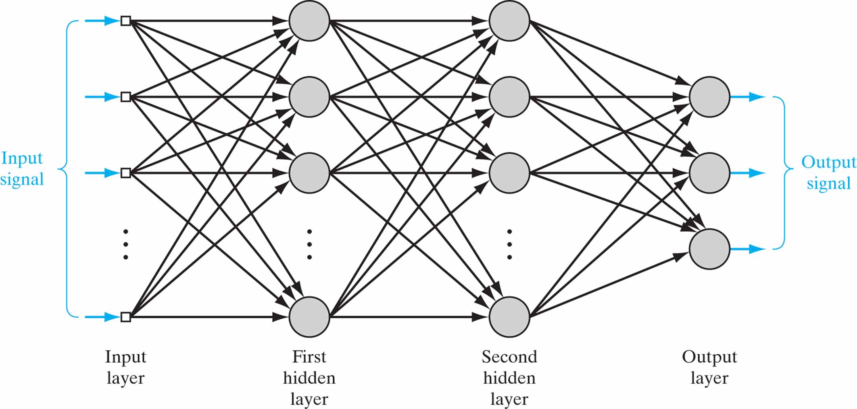

Slide 25
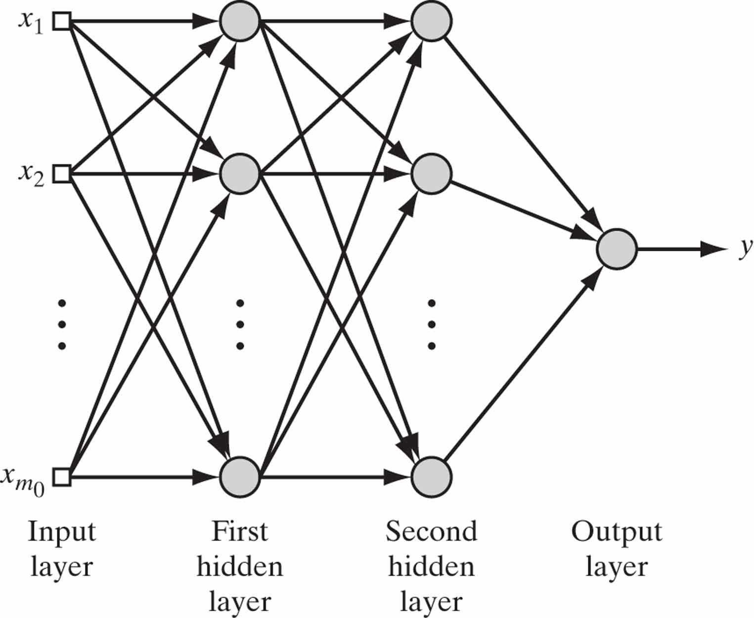

Slide 26
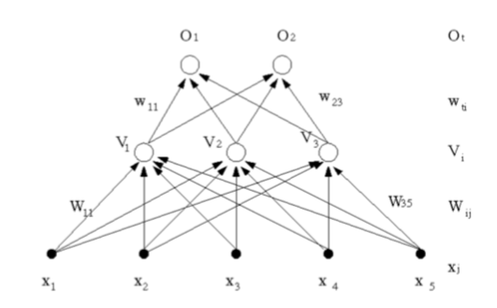
Back-propagation
The algorithm gives a prescription for changing the weights w_{ij} in any feed-forward network to learn a training set of input output pairs {x_{k},y_{k}}
We consider a simple two-layer network

Slide 27
The input pattern is represented by the five-dimensional vector x
nonlinear hidden units compute the output V₁, V₂, V₃
Two output units compute the output o₁ and o₂.
  The units V₁, V₂, V₃ are referred to as hidden units because we cannot see their outputs and cannot directly perform error correction

Slide 28
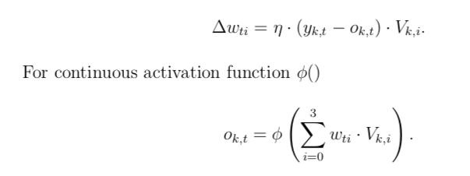
The output layer of a feed-forward network can be trained by the perceptron rule (stochastic gradient descent) since it is a Perceptron

Slide 29
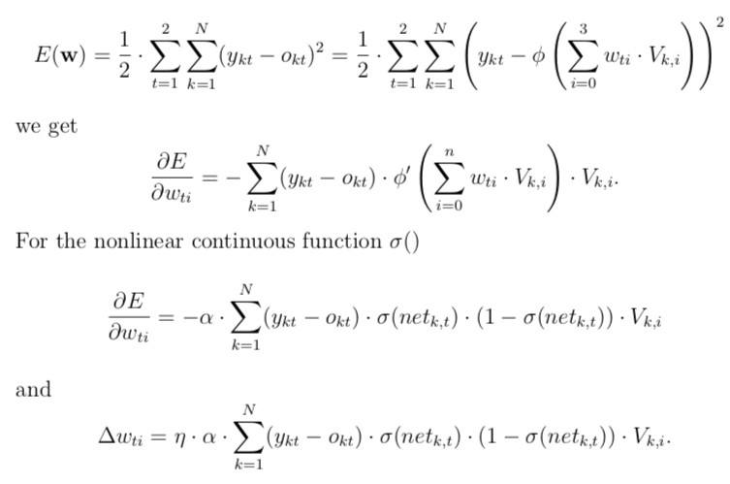

Slide 30
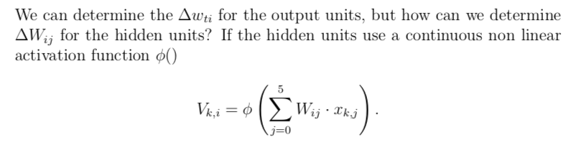

Slide 31
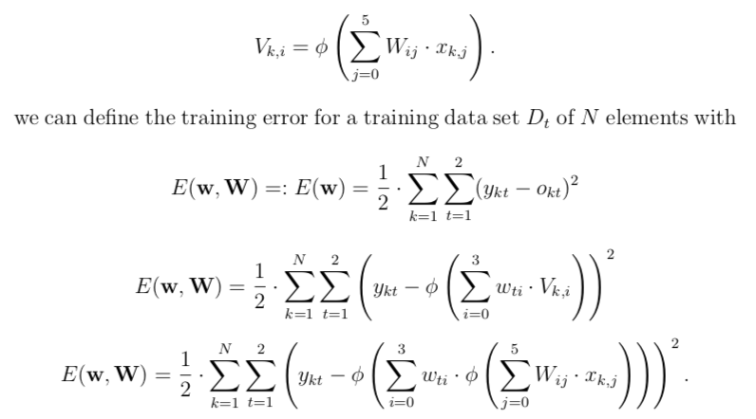

Slide 32
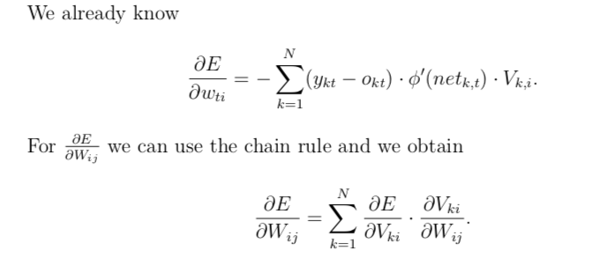

Slide 33
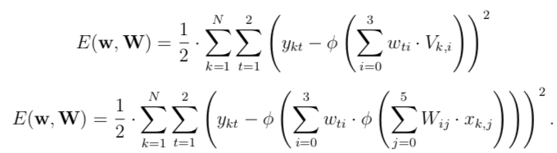
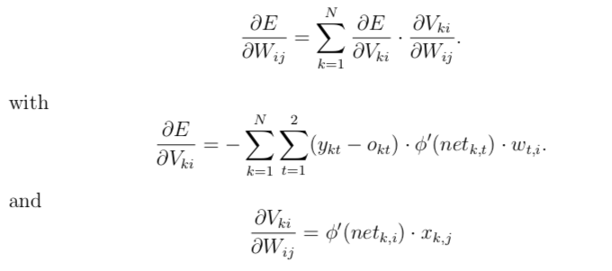
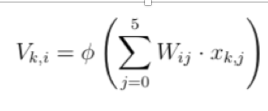

Slide 34
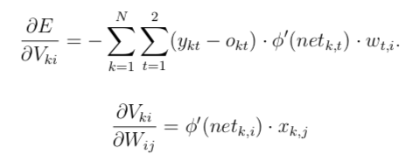



Slide 35
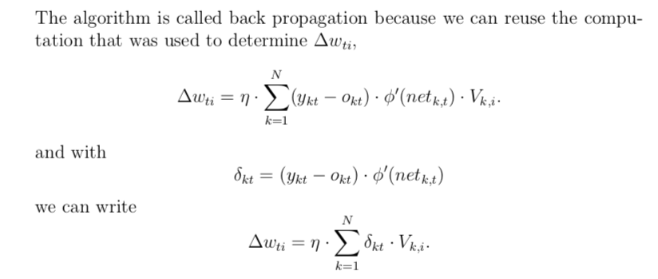

Slide 36
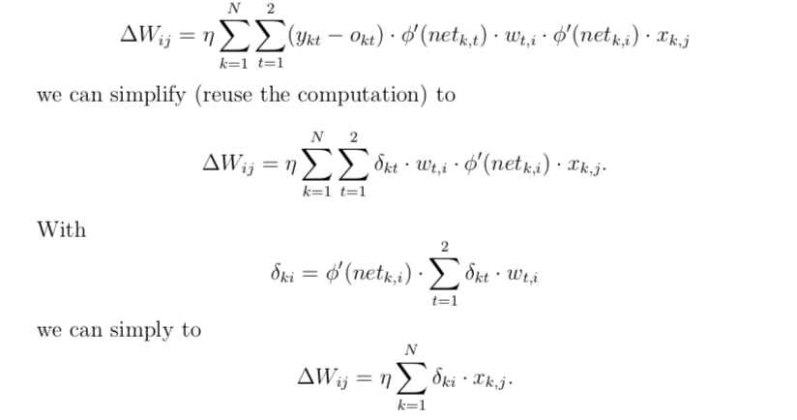


Slide 37
In general, with an arbitrary number of layers, the back-propagation update rule has always the form
  Where output and input refers to the connection concerned
  V stands for the appropriate input (hidden unit or real input, x_{d} )
  δ depends on the layer concerned

Slide 38
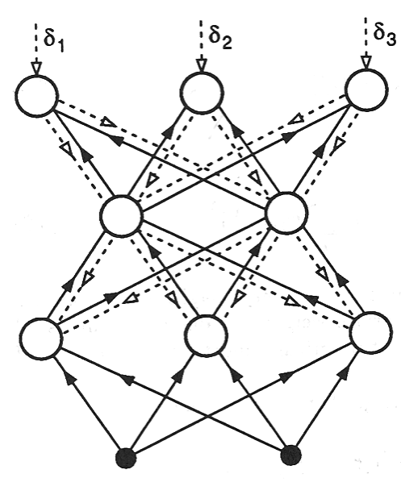
This approach can be extended to any numbers of layers
The coefficient are usual forward, but the errors represented by δ are propagated backward

Slide 39
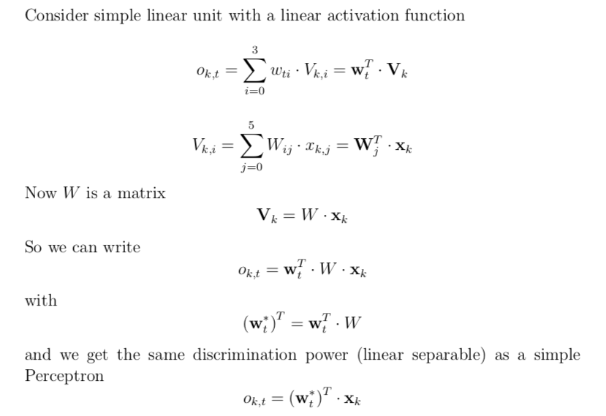
Networks with Hidden Linear Layers

Slide 40
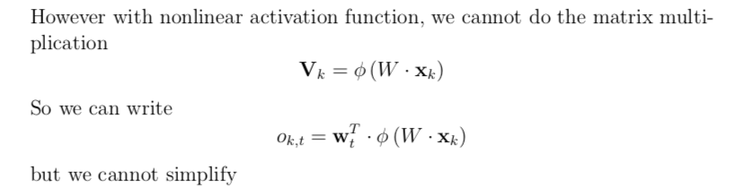

Slide 41
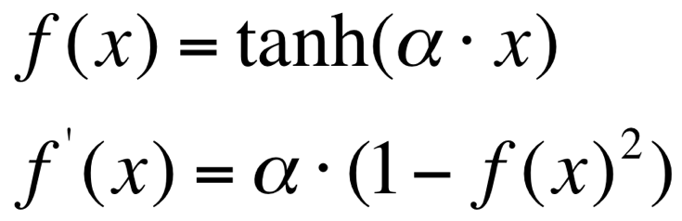
We have to use a nonlinear differentiable activation function in hidden units
  Examples:

Slide 42
Two kind of Units
Output Units
  Require Bias
  Preform Linear Separable Problems, means the input to them had to be somehow linearised
  Does not require non linear activation function,
  We should use sigmoid function or softmax to represent probabilities and to get better decision boundary.
Hidden Units
  Nonlinear activation function
  Feature Extraction
  Does it require Bias? It is commonly used
  Universal Approximation Theorem uses hidden units with bias.

Slide 43
Output Units are linear (Perceptron)
The hidden layer applies a nonlinear transformation from the input space to the hidden space
In the hidden space a linear discrimination can be performed
φ( )
φ( )
φ( )
φ( )
φ( )
φ( )
φ( )
φ( )
φ( )
φ( )
φ( )
φ( )
φ( )
φ( )
φ( )
φ( )

Slide 44
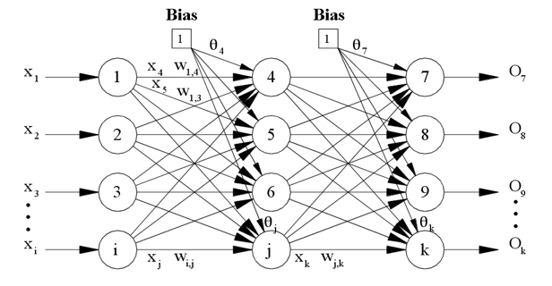
Bias?

Slide 45
Literature
Simon O. Haykin, Neural Networks and Learning Machine, (3rd Edition), Pearson 2008
  Chapter 4
Christopher M. Bishop, Pattern Recognition and Machine Learning (Information Science and Statistics), Springer 2006
  Chapter 5

Slide 46
Literature (Additional)
Introduction To The Theory Of Neural Computation (Santa Fe Institute Series Book 1), John A. Hertz, Anders S. Krogh, Richard G. Palmer, Addison-Wesley Pub. Co, Redwood City, CA; 1 edition (January 1, 1991)
  Chapter 6

Slide 47

Literature
Machine Learning - A Journey to Deep Learning, A. Wichert, Luis Sa-Couto, World Scientific, 2021
  Chapter 6

