Slide 1
Lecture 7: Decision Trees
Rui and Andreas

Slide 2
Learning through search (AI)
Blind search
  Impossible since the search space grows exponentially fast
Greedy Search
  Doesn't guarantee to find the best result
Relation to Gradient Descent, local minima problem….

Slide 3
When to consider Decision Trees
Instances describable by attribute-value pairs
Target function is discrete valued
Disjunctive hypothesis may be required
Possibly noisy training data
Missing attribute values
Examples:
  Medical diagnosis
  Credit risk analysis
  Object classification for robot manipulator (Tan 1993)

Slide 4
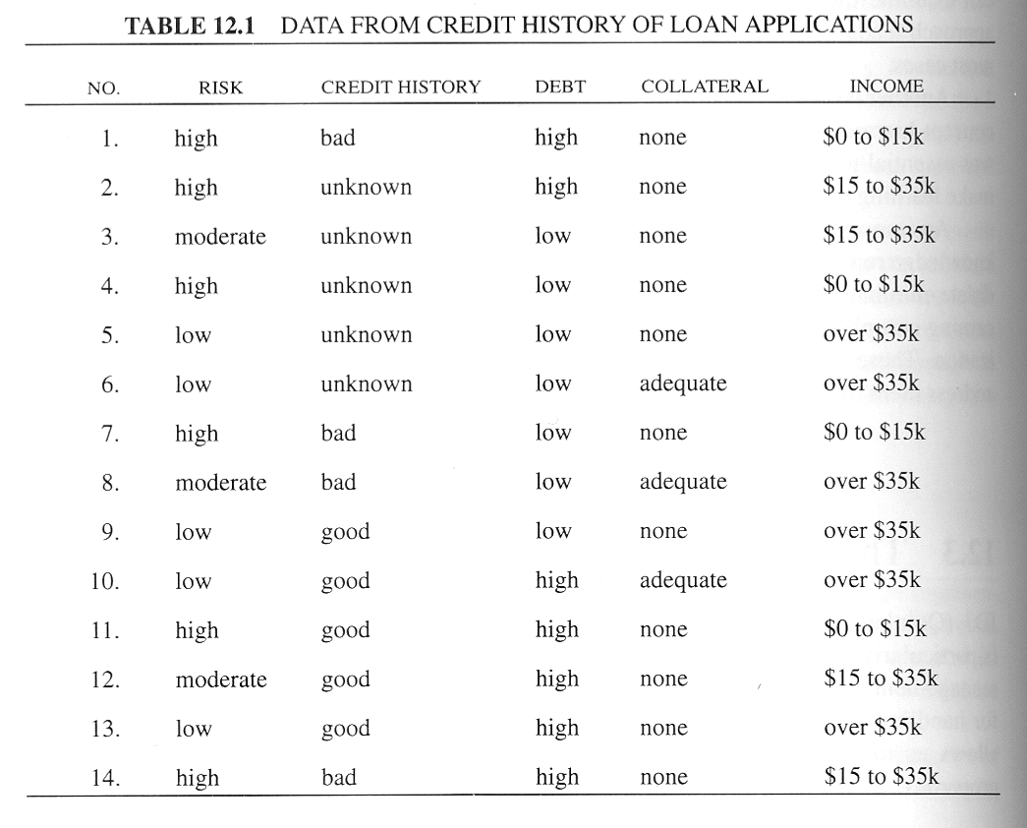

Slide 5
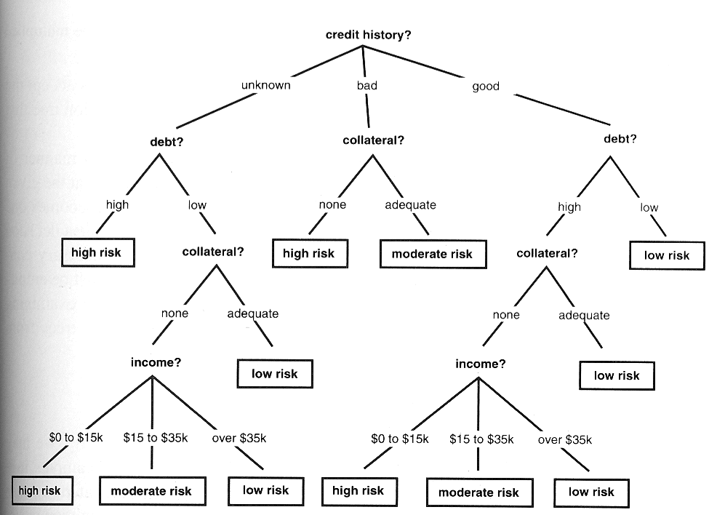
Decision tree for credit risk assessment

Slide 6
The decision tree represents the classification of the table
It can classify all the objects in the table
Each internal node represents a test on some property
Each possible value of that property corresponds to a branch of the tree
An individual of unknown type may be classified be traversing this tree

Slide 7
In classifying any given instance, the tree does not use all the properties in the table
Decision tree for credit risk assessment
If a person has a good credit history and low debit, we ignore her collateral income and classify her as low risk
In spite of omitting certain tests, the tree classifies all examples in the table

Slide 8
In general, the size of a tree necessary to classify a given set of examples varies according to the order with which properties (=attributes) are tested
Given a set of training instances and a number of different decision trees that correctly classify the instances, we may ask which tree has the greatest likelihood of correctly classifying using instances of the population?

Slide 9
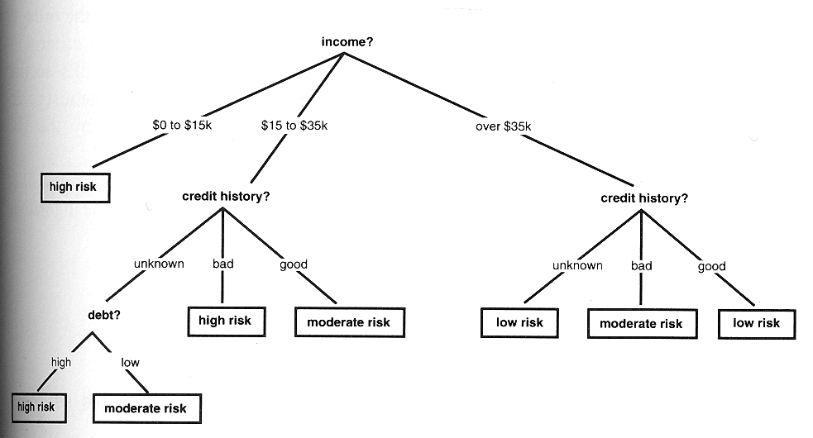
This is a simplified decision tree for credit risk assessment
  It classifies all examples of the table correctly

Slide 10
ID3 algorithm assumes that a good decision tree is the simplest decision tree
Heuristic:
  Preferring simplicity and avoiding unnecessary assumptions
  Known as Occam‘s Razor
The simplest decision tree that covers all examples should be the least likely to include unnecessary constraints

Slide 11

Occam Razor was first articulated by the medieval logician William of Occam in 1324
      born in the village of Ockham in Surrey (England) about 1285, believed that he died in a convent in Munich in 1349, a victim of the Black Death
      It is vain do with more what can be done with less..
  We should always accept the simplest answer that correctly fits our data
  The smallest decision tree that correctly classifies all given examples

Slide 12
Because the order of tests is critical to constructing a simple tree, ID3 relies heavily on its criteria for selecting the test at the root of each sub tree
How many different decision tree exist?
N=Number Of Attributes
There exist N! different ordering of attributes, different decision trees
Algorithm:
  Blind Search finds the global minima, the smallest decision tree (optimal)
  Compute all N! decision trees and chose the smallest one

Slide 13
N! grows extremely fast
N=4, 4!=24 manageable, no problem
Plot of N!

Slide 14
We have to use a heuristic function
ID3 selects a property to test at the current node of the tree and uses this test to partition the set of examples
The algorithm then recursively constructs a sub tree for each partition
This continuous until all members of the partition are in the same class
That class becomes a leaf node of the tree

Slide 15
Top-Down Induction of Decision Trees ID3
A ← the “best” decision attribute for next node
Assign A as decision attribute (=property) for node
3. For each value of A create new descendant
Sort training examples to leaf node according to
the attribute value of the branch
If all training examples are perfectly classified (same value of target attribute) stop, else iterate over new leaf nodes

Slide 17
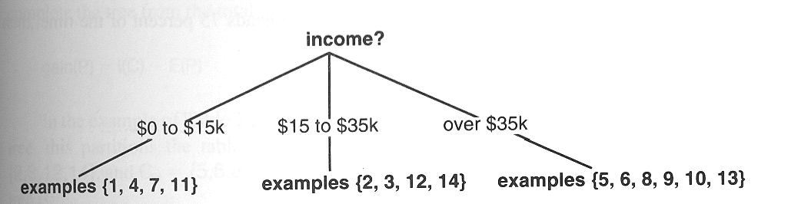
ID3 constructs the tree for credit risk assessment
  Beginning with the full table of examples, ID3 selects income as the root property using function selecting “best” property (attribute)
  The examples are divided, listed by their number in the list

Slide 18
ID3 applies the method recursively for each partition
  The partition {1,4,7,11} consists entirely of high-risk individuals, a node is created
  ID3 selects credit history property as the root of the subtree for the partition {2,3,12,14}
  Credit history further divides this partition into {2,3},{14} and {12}
ID3 implements a form of hill climbing in the space of all possible trees using a heuristic function
Doesn’t guarantee to find the smallest decision tree, can find a local maxima.

Slide 19
Hypothesis Space Search ID3 two classes: +,-
+ - +
A2
A1
+ - +
+ - -
+ - +
- - +
A2
A2
-
+ - +
-
Greedy Search
A3
A4
+ -
- +

Slide 20
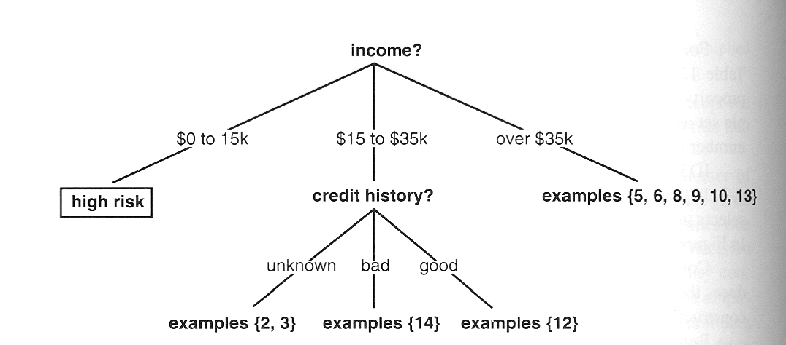

Slide 21
Heuristic function: Shannon Entropy
Shannon formalized these intuitions
Given a universe of messages M={m₁,m₂,...,m_{n}} and a probability p(m_{i}) for the occurrence of each message, the information content (also called entropy)of a message M is given

Slide 22
Information content of a message telling the outcome of the flip of an honest coin

Slide 23
However if the coin has been rigged to come up heads 75 percent

Slide 24
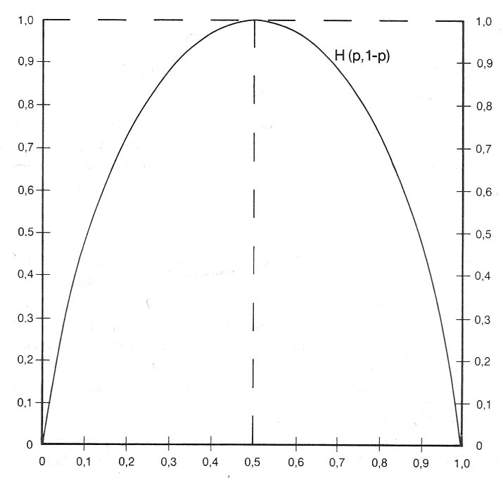
Only two probabilities

Slide 25
We may think of a decision tree as conveying information about the classification of examples in the decision table
The information content of the tree is computed from the probabilities of different classifications

Slide 26
The credit history loan table has following information
  p(risk is high)=6/14
  p(risk is moderate)=3/14
  p(risk is low)=5/14

Slide 27
For a given test, the information gain provided by making that test at the root of the current tree is equal to
Total information of the table - the amount of information needed to complete the classification after performing the test
The amount of information needed to complete the tree is defined as weighted average of the information content of each sub tree

Slide 28
  The amount of information needed to complete the tree is defined as weighted average of the information content of each sub tree by the percentage of the examples present
  C a set of training instances. If property (for example income) with n values, C will be divided into the subsets {C₁,C₂,..,C_{n}}
  Expected information needed to complete the tree after making P root

Slide 29
The gain from the property P is computed by subtracting the expected information to complete E(P) fro the total information

Slide 30
In the credit history loan table we make income the property tested at the root
This makes the division into
  C₁={1,4,7,11},C₂={2,3,12,14},C₃={5,6,8,9,10,13}

Slide 31
gain(income)=I(credit_table)-E(income)
gain(income)=1.531-0.564
gain(income)=0.967 bits
gain(credit history)=0.266
gain(debt)=0.581
gain(collateral)=0.756

Slide 32
Because income provides the greatest information gain, ID will select it as the root of the tree
The algorithm continues to apply this analysis recursively to each subtree, until it has completed the tree.

Slide 33
Day | Outlook | Temp. | Humidity | Wind | Play Tennis
D1 | Sunny | Hot | High | Weak | No
D2 | Sunny | Hot | High | Strong | No
D3 | Overcast | Hot | High | Weak | Yes
D4 | Rain | Mild | High | Weak | Yes
D5 | Rain | Cool | Normal | Weak | Yes
D6 | Rain | Cool | Normal | Strong | No
D7 | Overcast | Cool | Normal | Weak | Yes
D8 | Sunny | Mild | High | Weak | No
D9 | Sunny | Cold | Normal | Weak | Yes
D10 | Rain | Mild | Normal | Strong | Yes
D11 | Sunny | Mild | Normal | Strong | Yes
D12 | Overcast | Mild | High | Strong | Yes
D13 | Overcast | Hot | Normal | Weak | Yes
D14 | Rain | Mild | High | Strong | No

Slide 34
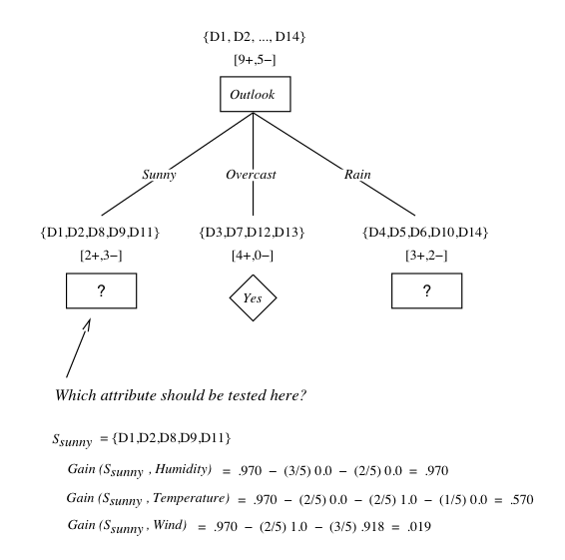

Slide 35
Overfiting
The ID3 algorithm grows each branch of the tree just deeply enough to perfectly classify the training examples
Difficulties may be present:
  When there is noise in the data
  When the number of training examples is too small to produce a representative sample of the true target function
The ID3 algorithm can produce trees that overfit the training examples

Slide 36
We will say that a hypothesis overfits the training examples - if some other hypothesis that fits the training examples less well actually performs better over the entire distribution of instances (included instances beyond training set)

Slide 37
Overfitting
Consider error of hypothesis h over
Training data: error_{train}(h)
Entire distribution D of data: error_{D}(h)
Hypothesis h∈H overfits training data if there is an alternative hypothesis h’∈H such that
error_{train}(h) < error_{train}(h’)
and
error_{D}(h) > error_{D}(h’)

Slide 38
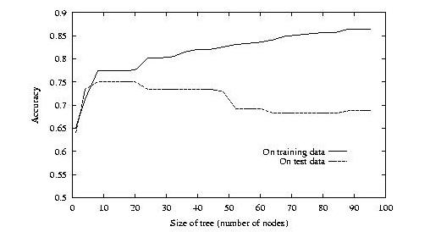
Overfitting

Slide 39
How can it be possible for a tree h to fit the training examples better than h’, but to perform more poorly over subsequent examples
One way this can occur when the training examples contain random errors or noise

Slide 40
Training Examples
Day | Outlook | Temp. | Humidity | Wind | Play Tennis
D1 | Sunny | Hot | High | Weak | No
D2 | Sunny | Hot | High | Strong | No
D3 | Overcast | Hot | High | Weak | Yes
D4 | Rain | Mild | High | Weak | Yes
D5 | Rain | Cool | Normal | Weak | Yes
D6 | Rain | Cool | Normal | Strong | No
D7 | Overcast | Cool | Normal | Weak | Yes
D8 | Sunny | Mild | High | Weak | No
D9 | Sunny | Cold | Normal | Weak | Yes
D10 | Rain | Mild | Normal | Strong | Yes
D11 | Sunny | Mild | Normal | Strong | Yes
D12 | Overcast | Mild | High | Strong | Yes
D13 | Overcast | Hot | Normal | Weak | Yes
D14 | Rain | Mild | High | Strong | No

Slide 41
Decision Tree for PlayTennis
Outlook
Sunny
Overcast
Rain
Humidity
Yes
Wind
High
Normal
Strong
Weak
No
Yes
No
Yes

Slide 42
Consider of adding the following positive training example, incorrectly labaled as negative
Outlook=Sunny, Temperature=Hot, Humidty=Normal, Wind=Strong, PlayTenis=No
The addition of this incorrect example will now cause ID3 to construct a more complex tree
Because the new example is labeled as a negative example, ID3 will search for further refinements to the tree

Slide 43
As long as the new erroneous example differs in some attributes, ID3 will succeed in finding a tree
ID3 will output a decision tree (h) that is more complex then the original tree (h‘)
Given the new decision tree a simple consequence of fitting noisy training examples, h‘ will outperform h on the test set

Slide 44
Avoid Overfitting
How can we avoid overfitting?
  Stop growing when data split not statistically significant
  Grow full tree then post-prune
How to select ``best'' tree:
  Measure performance over training data
  Measure performance over separate validation data set

Slide 45
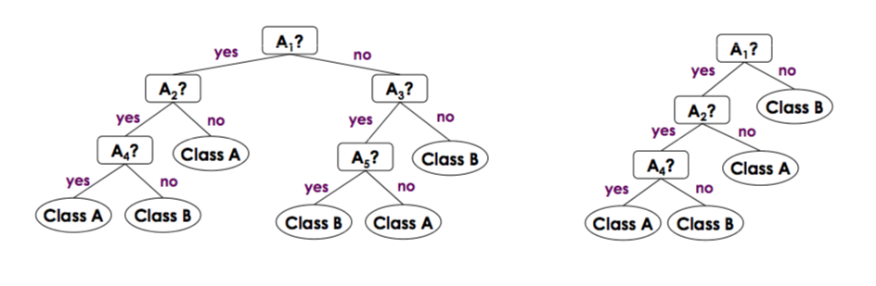
Pruning
Remove the least reliable branches

Slide 46
Quinlan strategies of C4.5
Derive an initial rule set by enumerating paths from the root to the leaves
Generalize the rules by possible deleting conditions deemed to be unnecessary
Group the rules into subsets according to the target classes they cover
  Delete any rules that do not appear to contribute to overall performance on that class
Order the set of rules for the target classes, and chose a default class to which cases will be assigned

Slide 47
The resultant set of rules will probably not have the same coverage as the decision tree
Its accuracy should be equivalent
Rules are much easier to understand
Rules can be tuned by hand by an expert

Slide 48
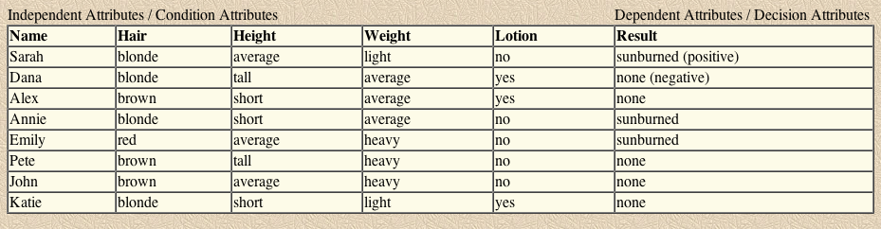
From Trees to Rules
Once an identification tree is constructed, it is a simple matter to concert it into a set of equivalent rules
      Example from Artificial Intelligence, P.H. Winston 1992

Slide 49
An ID3 tree consistent with the data
Hair Color
Blond
Brown
Red
Alex
Pete
John
Lotion Used
Emily
No
Yes
Sarah
Annie
Dana
Katie
Sunburned
Not Sunburned

Slide 50
Corresponding rules
If the person‘s hair is blonde
and the person uses lotion
then nothing happens
If the person‘s hair color is blonde
and the person uses no lotion
then the person turns red
If the person‘s hair color is red
then the person turns red
If the person‘s hair color is brown
then nothing happens

Slide 51
Unnecessary Rule Antecedents should be eliminated
If the person‘s hair is blonde
and the person uses lotion
then nothing happens
Are both antecedents are really necessary?
Dropping the first antecedents produce a rule with the same results
If the the person uses lotion
then nothing happens
To make such reasoning easier, it is often helpful to construct a contingency table
it shows the degree to which a result is contingent on a property

Slide 52
  In the following contingency table one sees the number of lotion users who are blonde and not blonde and are sunburned or not
    Knowledge about whether a person is blonde has no bearing whether it gets sunburned
 | Not sunburned | Sunburned
Person is blonde (uses lotion) | 2 | 0
Person is not blonde (uses lotion) | 1 | 0

Slide 53
Check for lotion for the same rule
Has a bearing on the result
 | Not sunburned | Sunburned
Person uses lotion | 2 | 0
Person uses no lotion | 0 | 2

Slide 54
Unnecessary Rules should be Eliminated
If the person uses lotion
then nothing happens
If the person‘s hair color is blonde
and the person uses no lotion
then the person turns red
If the person‘s hair color is red
then the person turns red
If the person‘s hair color is brown
then nothing happens

Slide 55
Note that two rules have a consequent that indicate that a person will turn red, and two that indicate that nothing happens
One can replace either the two of them by a default rule

Slide 56
Default rule
If the person uses lotion
then nothing happens
If the person‘s hair color is brown
then nothing happens
If no other rule applies
then the person turns red

Slide 57
What is CART?
Classification And Regression Trees
Developed by Breiman, Friedman, Olshen, Stone in early 80’s.
  Introduced tree-based modeling into the statistical mainstream
  Rigorous approach involving cross-validation to select the optimal tree
One of many tree-based modeling techniques.
  CART -- the classic
  CHAID
  C5.0
  Software package variants (SAS, S-Plus, R…)
  Note: the “rpart” package in “R” is freely available

Slide 58
Idea: Recursive Partitioning
Take all of your data.
Consider all possible values of all variables.
Select the variable/value (X=t₁) that produces the greatest “separation” in the target.
    (X=t₁) is called a “split”.
If X< t₁ then send the data to the “left”; otherwise, send data point to the “right”.
Now repeat same process on these two “nodes”
    You get a “tree”
    Note: CART only uses binary splits.

Slide 59

Gini Index
The Gini Index (used in CART) measures the impurity of a data partition D
m: the number of classes
p_{i}: the probability that a tuple in D belongs to class C_{i}

Slide 60
Gini index of the flip of an honest coin
  1 - (0.5² + 0.5²)=0.5
Coin has been rigged to come up heads 75 percent
  1 - (0.75² + 0.25²)=0.375

Slide 61
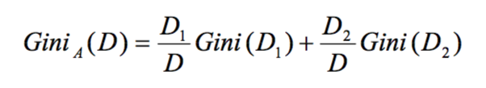
The Gini Index considers a binary split for each attribute A, say D1 and D2. The Gini index of D given that partitioning is:
A weighted sum of the impurity of each partition
  Weighted mean, the same as before…..

Slide 62

The reduction in impurity is given by
The attribute that maximizes the reduction in impurity is chosen as the splitting attribute

Slide 63
Binary Split: Continuous-Valued Attributes
D: a data partition
Consider attribute A with continuous values
To determine the best binary split on A
What to examine?
Examine each possible split point
The midpoint between each pair of (sorted) adjacent values is taken as a possible split-point

Slide 64
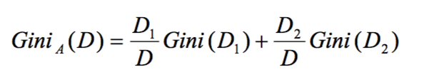
How to examine?
For each split-point, compute the weighted sum of the impurity of each of the two resulting partitions
    (D1: A<= split-point, D2: A > split-point)
The split-point that gives the minimum Gini index for attribute A is selected as its splitting subset

Slide 65
Binary Split: Discrete-Valued Attributes
D: a data partition
Consider attribute A with v outcomes {a₁...,a_{v}}
To determine the best binary split on A
  Examine the partitions resulting from all possible subsets of {a₁...,a_{v}}
  Each subset S_{A} is a binary test of attribute A of the form “A∈S_{A}?”
  2^{v} possible subsets. We exclude the power set and the empty set, then we have 2^{v}-2 subsets

Slide 66
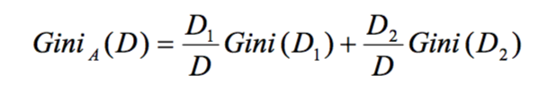
How to examine?
For each subset, compute the weighted sum of the impurity of each of the two resulting partitions
The subset that gives the minimum Gini index for attribute A is selected as its splitting subset

Slide 67
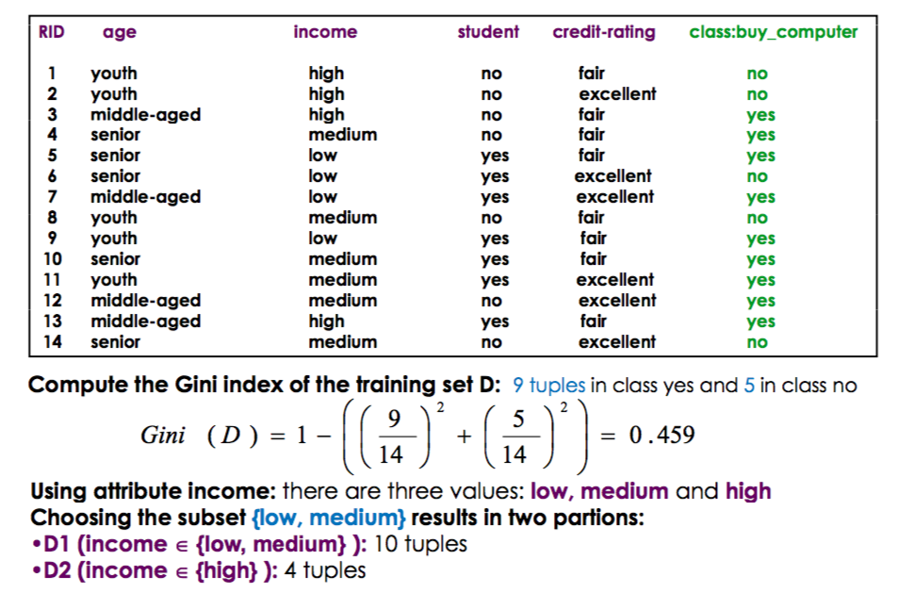

Slide 68
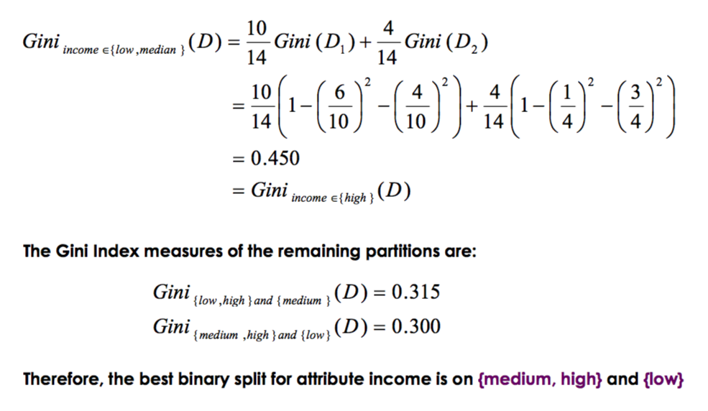

Slide 69
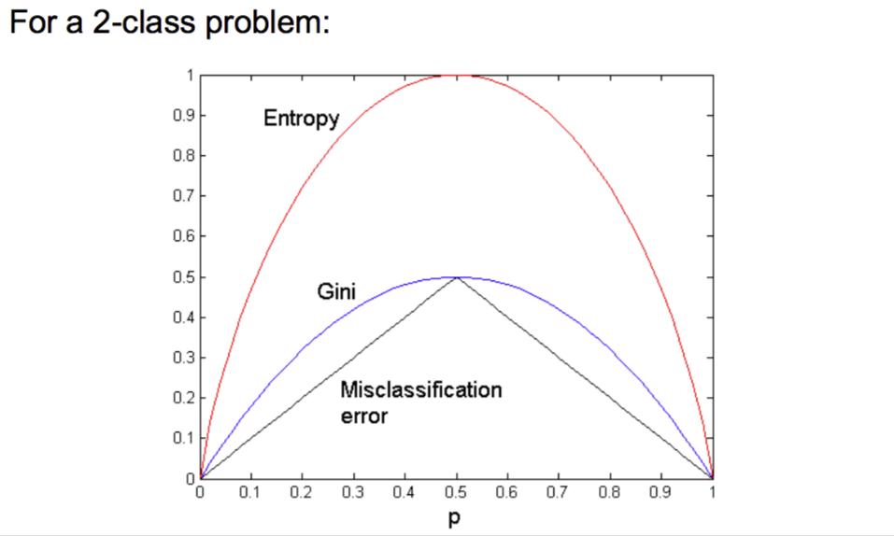
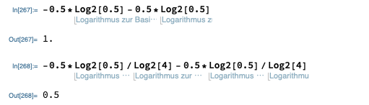
This argument does not halt ☺ :

Slide 70
Shannon Information vs. Gini
-0.5*Log₂[0.5] - 0.5*Log₂[0.5]=-Log₂[0.5]=1
-Log₂[0.25]=2
…
-Log₂[1/256]=8
1 - (0.5² + 0.5²)=0.5
1 - (0.25² + 0.25² + 0.25² + 0.25²)=0.75
1 - (256*(1/256)²=0.996094

Slide 71
Shannon’s entropy for equal distribution vs. Gini…
Plot[-Log2[x], {x, 0.01, 1}] Plot[1 - ((1/x)*x^2), {x, 0.01, 1}]
Shannon’s entropy grows nonlinear! Does not converge
Gini grows linear, converges to one

Slide 72
Comparing Attribute Selection Measures
Information Gain
    Biased towards multivalued attributes
    Multivalued Splits
Gini Index
    Biased towards multivalued attributes
    Has difficulties when the number of classes is large
    Tends to favor tests that result in equal-sized partitions and purity in both partitions
    Only uses binary splits

Slide 73
Literature
Tom M. Mitchell, Machine Learning, McGraw-Hill; 1st edition (October 1, 1997)
  Chapter 3
Christopher M. Bishop, Pattern Recognition and Machine Learning (Information Science and Statistics), Springer 2006
  Section 14.4

Slide 74
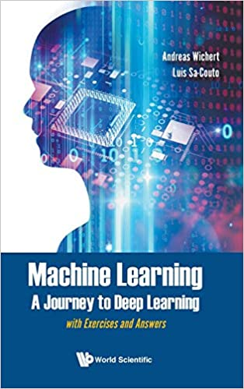
Literature
Machine Learning - A Journey to Deep Learning, A. Wichert, Luis Sa-Couto, World Scientific, 2021
  Chapter 2, Section 2.5
      C Decision Trees

